Slide 1
Tour Guide and Management
By Batch-01

Slide 2
Objectives:
To develop an interactive system that helps potential visitors get enough information about the various destinations that may ease their tour.
To explore the problems encountered in the management of the existing manual tourism system.
To design a web based system that will make information more detailed, effective, and accurate, and ease the delay encountered with the existing manual system.
To implement a web based tourism system that will help people to appreciate the state’s natural endowment and also serve as a complementary tool for tourism management.

Slide 3
Performance Needs:
It should load in very less time (seconds).
User Interface should be intuitive.
Should run most of the hardware devices and support multiple web browsers.
Functional Requirements:
Administrative Module:This module provides administrator related functionality. Administrator manages all information and has access rights to add, delete, edit and view the data related to places, travels, routes, bookings, restaurants etc.
Travels Module:This module provides the details of various travel agencies. A user can select the appropriate agency depending on convenience and accessibility.
Routes Module:This module provides information related to various routes connecting sources and destinations. For each route, information such as source, destination, fare, reservation details, pick up points etc are provides. Only administrator can add , delete, edit and manage the data. Users can only view the information.

Slide 4
4. Reservations Module: This module provides functionalities that allow a user to book tickets or cancel previously booked tickets. The module maintains the details of all reservations made so far and allows administrator to either confirm or reject the bookings.
5. Testimonials Module: Users of this application can post their opinions, complaints and suggestions regarding this portal and services to the administrator. Accordingly, the administrator can take various steps to act on the complaints and suggestions.

Slide 5
Non-Functional Requirements:
Hardware Requirements:
Processor - At least 2.0 GHZ
RAM - At least 2GB
Software Requirements:
Operating System - Windows.
Frond End - PHP, HTML, CSS, JavaScript, Ajax.
Back End - MySQL
Editor Tools - Atom, Notepad ++
Other Graphics Tools - Adobe Photoshop.
Web Browser - Google Chrome, Firefox, or any compatible update browsers

Slide 6
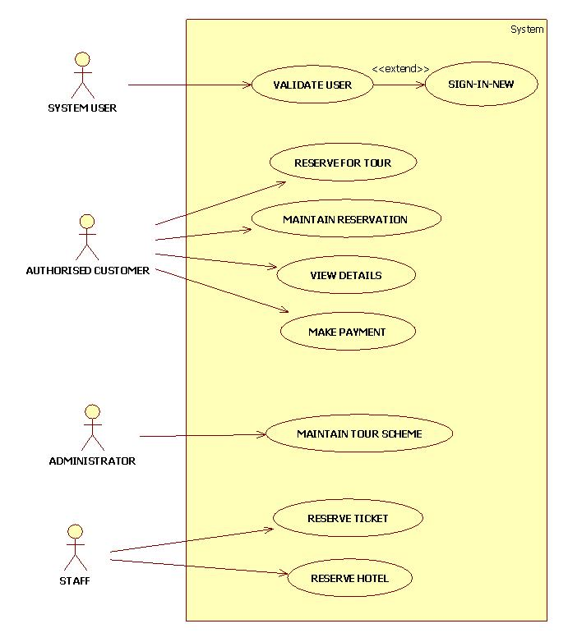
Use-Case Diagram

Slide 7
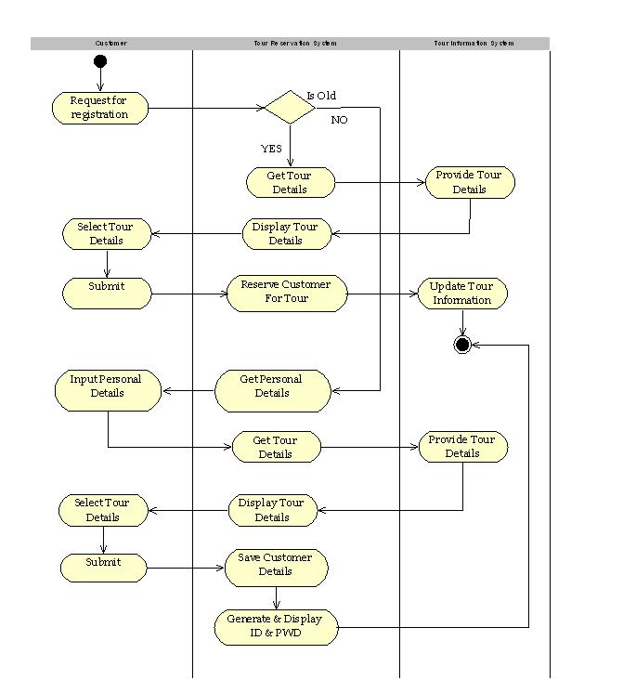
Activity Diagram

Slide 8
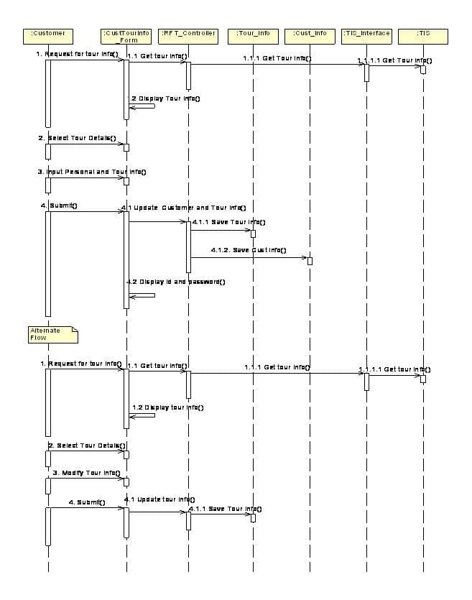
Sequence Diagram

